Slide 1
Lovely Professional University
CSE 326
PROJECT REPORT
On
CHILD CARE PRODUCTS
SUBMITTED TO: GROUP MEMBERS:
MANU BALI (MAM) CH.JAGDISH(22)(K19HZ)
CSE-326 JEEVAN KUMAR(23)(K19HZ)
HTML PIYUSH MISHRA(24)(K19HZ)
GROUP-1

Slide 2
OUTLINES:-
INTRODUCTION
PROJECT DESCRIPTION
MODULES
CONCEPTS USED
INTRODUCTION ABOUT :-
HTML
CSS
JAVASCRIPT
SCREENSHOTS OF WEBSITE
WORK DONE BY THE TEAM MEMBERS

Slide 3
INTRODUCTION:-
This is a small project on the child care products.
The basic idea is that customer can book any child care products .People must have there account to book any product in the website if they have not account they can not book any products. For that they can create an account.

Slide 4
Project dEscription:-
This project is basically based on HTML ,CSS and Javascript. In this project there is four section.
first part contain website logo and login and signup button. If the user have not account they can make there account by using signup button.
Second part contain about the child care product, their costs and offers available on them.
Third part of this project contain the about booking .

Slide 5
Modules:-
Login-This module helps to user to open the website with their account. It contain email id and password.
Sign up-This module is help user to create an account if they have not account.
Search-This module is help user to search for the child care product.
Chat box-With this module user can put their message about the difficulty they face in the website so that we can fix it.

Slide 6
Concepts used:-
Tag names, attributes and descriptions:
<!DOCTYPE> | This is the document type tag, which is actually not a tag, but a declaration of the version of HTML that is used. It is to help the browser understand the version and type of web page, without which the browser would not be able to even recognize the webpage. The document type tag does not have an end tag.
<a> | The anchor tag, as this tag is called, interconnects two pages (unidirectional) with the help of a page address. The link of the interconnected page needs to be inserted as part of the href attribute, which makes the text accessible, and directs you to the said page on clicking the linked text.
<b> | The bold tag is used, as the name suggests, to make text bold, or stand out from other text on a webpage. Similar to the bold effect found in most word processing programs.

Slide 7
<body> | The body tag displays all the content of an HTML document, such as text, hyperlinks, images, tables, lists, etc.
<br> | This tag lets you add a line break to the text. It puts anything that comes after it on a new line. The line break tag is an empty tag, meaning it has no end tag.
<button> | The button tag defines a clickable button. Inside this tag you can put content, like text or images.
<center> | The center tag is used to align elements or text to the center of the page. This tag is not supported in HTML 5, CSS properties need to be used instead.
<form> | The form tag is one of the most important aspects of interactive pages. It is used to create an HTML form for user input.

Slide 8
<font> | This tag is similar to the basefont tag, except it applies the font style to the content and elements within the tag, and not across the whole page. The font tag is not supported in HTML 5, CSS is used instead.
<footer> | The footer tag defines a footer for a document or section. Footer naturally specifies the author and copyright information, among other things. You can have several footer elements in one document.
<head> | As the name states, the head tag is mainly responsible for the functioning of the body. The head tag includes all the script and style elements, and must include a title for the document
<header> | The header tag specifies a header for a document or section. The header element should be used as a container for introductory content or a set of navigational links.

Slide 9
<h1> to <h6> | The h1 to h6 tags are used to define HTML headings. They add highlight and font style to let the heading of the section stand out. h1 defines the most important heading, while h6 defines the least important.
<hr> | The hr tag defines a thematic break in an HTML page (e.g., a shift of topic).
<html> | The HTML tag tells the browser that this is an HTML document. This tag is the container for all other HTML elements (except for the <!DOCTYPE> tag).
<i> | The italic tag is used to highlight important words or sentences within text. Similar to the Italic text found in most word processing programs.

Slide 10
<input> | As the name suggests, an author can accept inputs from users making a page interactive, using this tag. It is used within the form tag.
<option> | This tag creates the items for selection in the drop down list, i.e., options to be selected from the select tag.
<p> | The p tag defines a paragraph on the page.
<pre> | This tag lets you used preformatted text, where the user can define or print text on page ‘as is’ written inside the tag. It preserves line breaks and spaces, hence the br tag is not required.
<script> | The script tag enables the author to insert scripting language into document, such as JavaScript. This tag lets you validate, manipulate, and affect content dynamically.

Slide 11

Html:-
HTML elements are the building blocks of HTML pages. With HTML constructs, images and
other objects such as interactive forms may be embedded into the rendered page. HTML provides
a means to create structured documents by denoting structural semantics for text such as headings,
paragraphs, lists, links, quotes and other items. HTML elements are delineated by tags, written using
angle brackets. Tags such as <img /> and <input /> directly introduce content into the page. Other
tags such as <p> surround and provide information about document text and may include other tags
as sub-elements. Browsers do not display the HTML tags, but use them to interpret the content of the page.

Slide 12

CSS:-
Cascading Style Sheets (CSS) is a style sheet language used for describing the presentation of a document written in a markup language like HTML. CSS is a cornerstone technology of the World Wide Web, alongside HTML and JavaScript.
CSS is designed to enable the separation of presentation and content, including layout, colors, and fonts. This separation can improve content accessibility, provide more flexibility and control in the specification of presentation characteristics, enable multiple web pages to share formatting by specifying the relevant CSS in a separate .css file, and reduce complexity and repetition in the structural content.
Separation of formatting and content also makes it feasible to present the same markup page in different styles for different rendering methods, such as on-screen, in print, by voice (via speech-based browser or screen reader), and on Braille-based tactile devices. CSS also has rules for alternate formatting if the content is accessed on a mobile device.

Slide 13

JAVASCRIPT:-
JavaScript often abbreviated as JS, is a programming language that conforms to the ECMA Script specification. JavaScript is high-level, often just-in-time compiled, and multi-paradigm. It has curly-bracket syntax, dynamic typing, prototype-based object-orientation, and first-class functions.
Alongside HTML and CSS, JavaScript is one of the core technologies of the World Wide Web. JavaScript enables interactive web pages and is an essential part of web applications. The vast majority of websites use it for client-side page behavior, and all major web browsers have a dedicated JavaScript engine to execute it.
As a multi-paradigm language, JavaScript supports event-driven, functional, and imperative programming styles. It has application programming interfaces (APIs) for working with text, dates, regular expressions, standard data structures, and the Document Object Model (DOM). However, the language itself does not include any input/output (I/O), such as networking, storage, or graphics facilities, as the host environment (usually a web browser) provides those APIs.

Slide 14
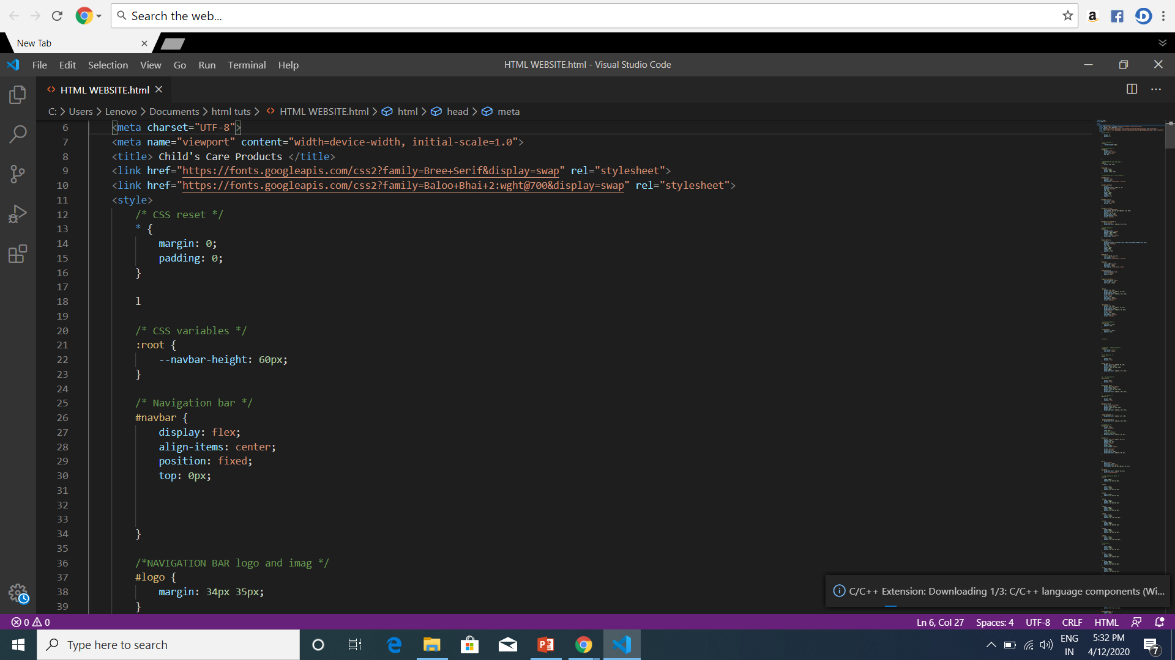
SCREENSHOTS:-

Slide 15
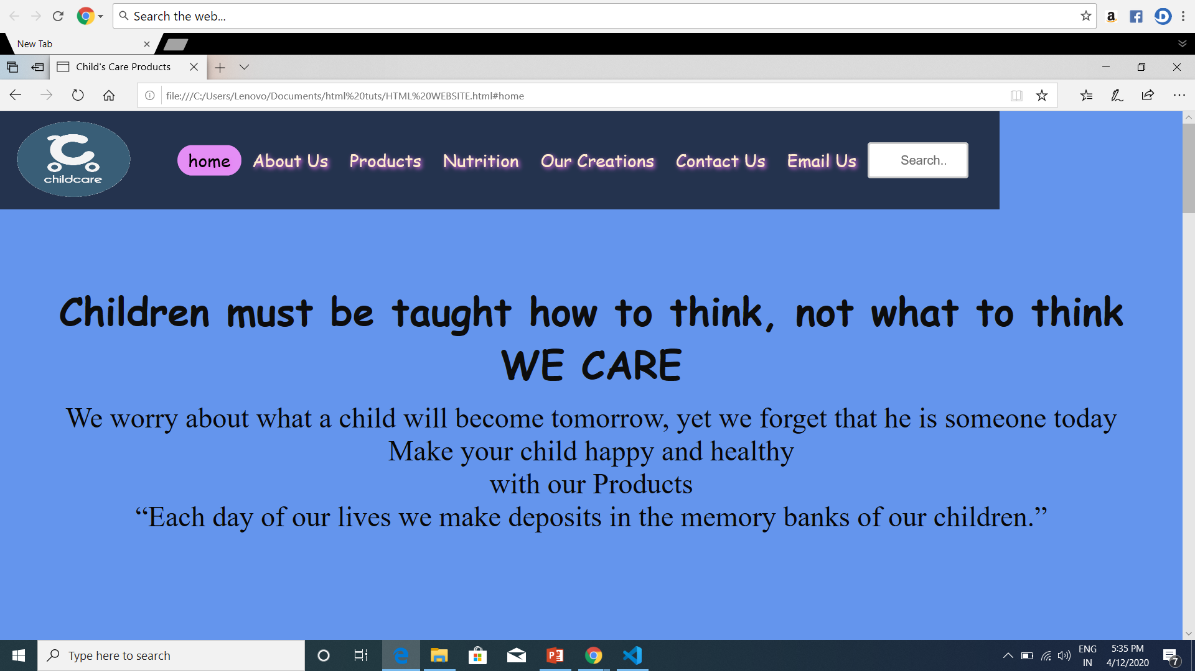

Slide 16
TEAM WORK:-
TEAM WORK DONE BY THE MEMBERS:-
1.CH.JAGDISH:-
I design the final report on Microsoft power point presentation and also I designed and learned the Javascript and I called the functions on website by adding Graphics and texts to perform any action like for LOGIN page or SIGNUP page.
2.PIYUSH MISHRA:-
I design the website with the help of HTML language and used some CSS code in it. I prepared this on VISUAL CODE as this is the less time consumption programming language. I added the colors and the page layouts and also the font style.
3.JEEVAN KUMAR:-
I had used form tag to make a form type when user can put their E-mail ID and Password. I wrote all the tags and attributes used in fronted page to develop this CHILD CARE PRODUCTS website.

Slide 17
THANKYOU

